Slide 1

Service registry: Eureka

Slide 2
Service Registry
Like the phone book for microservices
Services register themselves with their location and other meta-data
Clients can lookup other services
Netflix Eureka

Slide 3
Without Eureka
AccountService
call
CustomerService
Address is hard coded

Slide 4
Using Eureka
register
AccountService
call
Eureka
register
CustomerService
discover
Address is fetched from the registry

Slide 5
Why service registry/discovery?
Loosely coupled services
Service consumers should not know the physical location of service instances.
We can easily scale up or scale down service instances
Increase application resilience
If a service instance becomes unhealthy or unavailable, the service discovery engine will remove that instance from the list of available services.

Slide 6
Eureka Server
@SpringBootApplication
@EnableEurekaServer
public class EurekaServerApplication {
public static void main(String[] args) {
SpringApplication.run(EurekaServerApplication.class, args);
}
}
application.yml
server:
port: 8761
eureka:
client:
registerWithEureka: false #telling the server not to register himself
fetchRegistry: false
bootstrap.yml
spring:
application:
name: Eureka Server

Slide 7
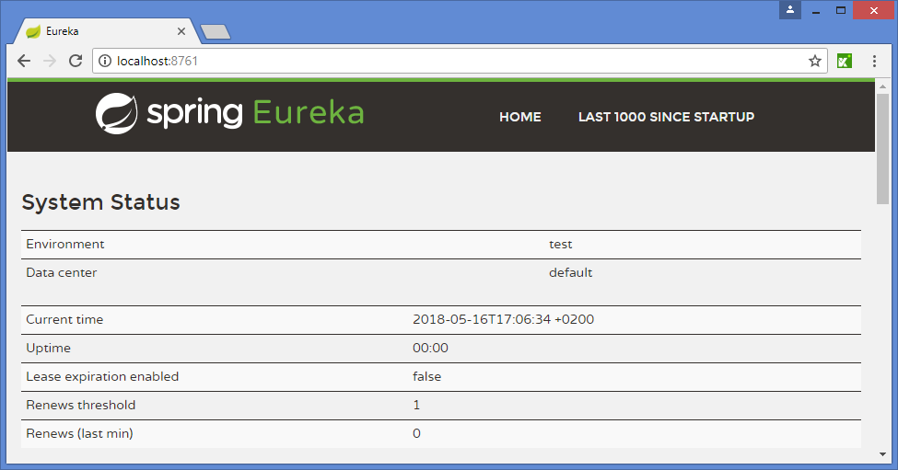
Running Eureka

Slide 8
AccountService
@SpringBootApplication
@EnableDiscoveryClient
public class AccountServiceApplication {
public static void main(String[] args) {
SpringApplication.run(AccountServiceApplication.class, args);
}
}
application.yml
server:
port: 8090
eureka:
client:
serviceUrl:
defaultZone: http://localhost:8761/eureka/
bootstrap.yml
spring:
application:
name: AccountService

Slide 9
AccountService
@RestController
public class AccountController {
@RequestMapping("/account/{customerid}")
public Account getName(@PathVariable("customerid") String customerId) {
return new Account("1234", "1000.00");
}
}
public class Account {
private String accountNumber;
private String balance;
...
}

Slide 10
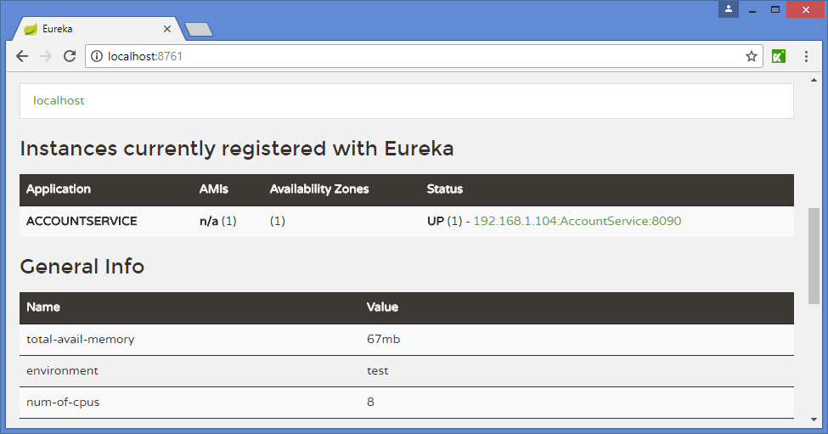
Running the AccountService

Slide 11
CustomerService
@SpringBootApplication
@EnableDiscoveryClient
@EnableFeignClients
public class AccountServiceApplication {
public static void main(String[] args) {
SpringApplication.run(AccountServiceApplication.class, args);
}
}
Use Feign
application.yml
server:
port: 8091
eureka:
client:
serviceUrl:
defaultZone: http://localhost:8761/eureka/
bootstrap.yml
spring:
application:
name: CustomerService

Slide 12
CustomerService: the controller
@RestController
public class CustomerController {
@Autowired
AccountFeignClient accountClient;
@RequestMapping("/customer/{customerid}")
public Account getName(@PathVariable("customerid") String customerId) {
Account account = accountClient.getName(customerId);
return account;
}
@FeignClient("AccountService")
interface AccountFeignClient {
@RequestMapping("/account/{customerid}")
public Account getName(@PathVariable("customerid") String customerId);
}
}
Name of the service
Use Feign to access the AccountService
application.yml
server:
port: 8091

Slide 13
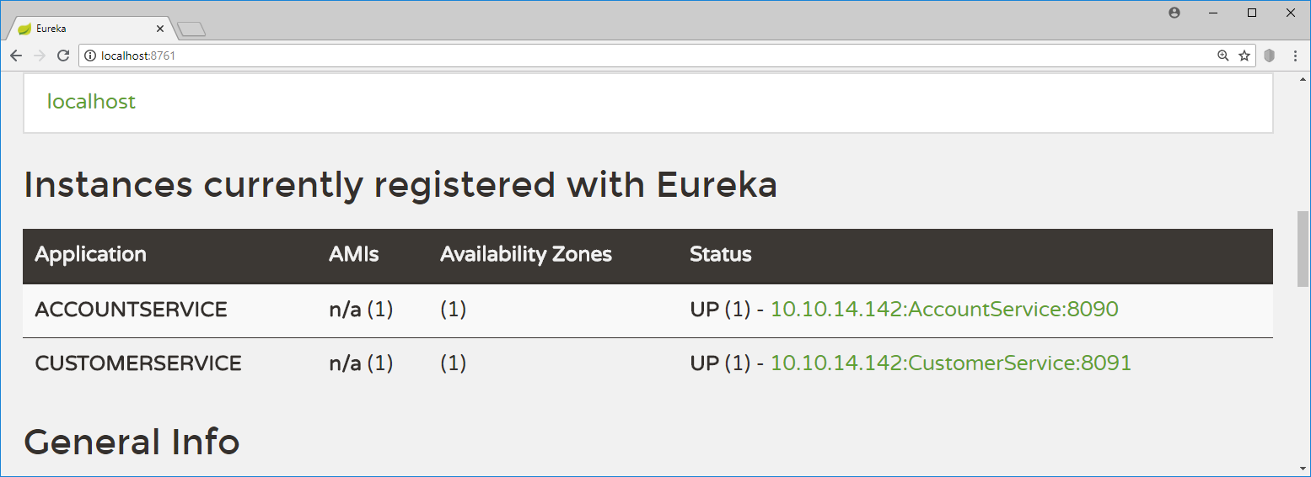
Running the CustomerService

Slide 14
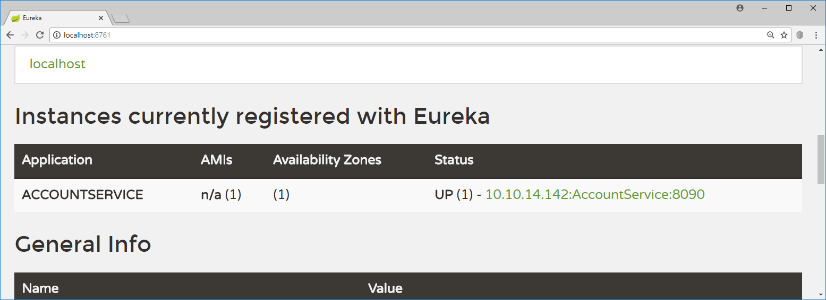
Stopping the CustomerService
Eureka monitors the health of registered services.
If we stop the CustomerService, Eureka will notice that automatically

Slide 15
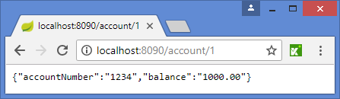
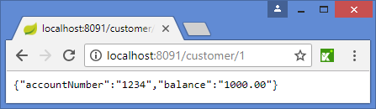
Using Eureka
AccountService
register
Eureka
call
CustomerService
register
discover

Slide 16
Registering with Eureka
When a service registers with Eureka, Eureka will wait for 3 successive health checks over the course of 30 seconds before the service becomes available in Eureka

Slide 17
Eureka high availability
Multiple Eureka servers can be configured as such that they replicate the contents of their registries.
application.yml
server:
port: 8091
eureka:
client:
serviceUrl:
defaultZone: http://localhost:8761/eureka/
This can be a comma separated list of Eureka instances.
If the first instance does not respond, we try the next instance

Slide 18

Load Balancing: Ribbon

Slide 19
Running 2 AccountServices using profiles
localhost:8090
localhost:8091
AccountService
CustomerService
AccountService
localhost:8092
Registry service
localhost:8761

Slide 20
Spring Profiles
@RestController
@Profile("One")
public class AccountController1 {
@GetMapping("/account/{customerid}")
public Account getName(@PathVariable("customerid") String customerId) {
System.out.println("getName() on AccountController1 is called");
return new Account("1234", "1000.00");
}
}
Define a profile
@RestController
@Profile("Two")
public class AccountController2 {
@GetMapping("/account/{customerid}")
public Account getName(@PathVariable("customerid") String customerId) {
System.out.println("getName() on AccountController2 is called");
return new Account("1234", "1000.00");
}
}

Slide 21
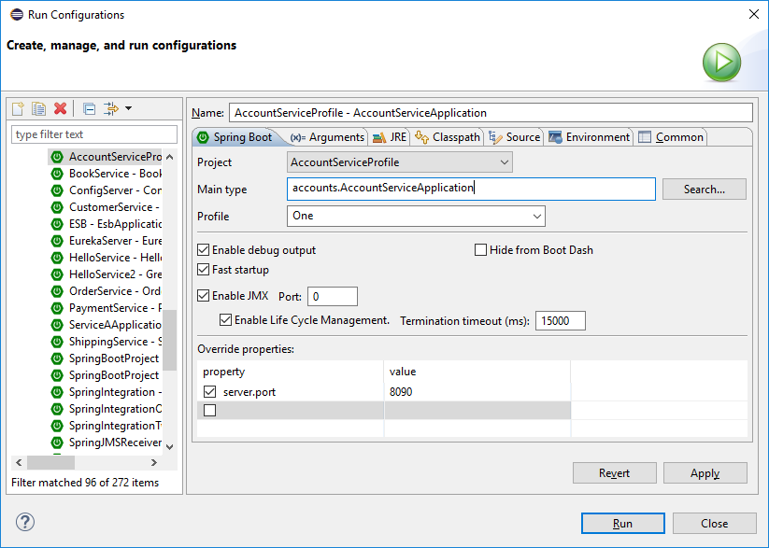
Start the first instance
Activate profile “One”
Set server.port

Slide 22
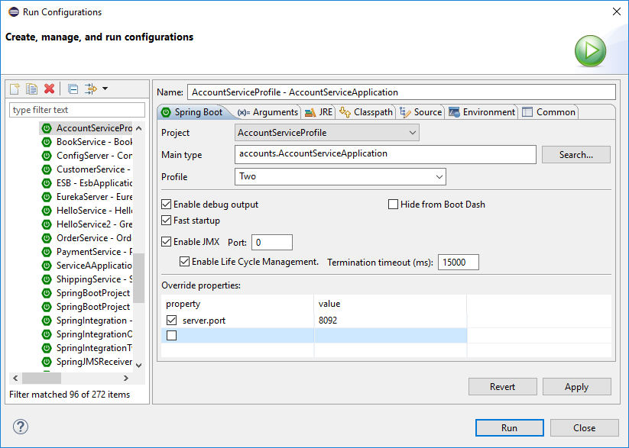
Start the second instance
Activate profile “Two”
Set server.port

Slide 23
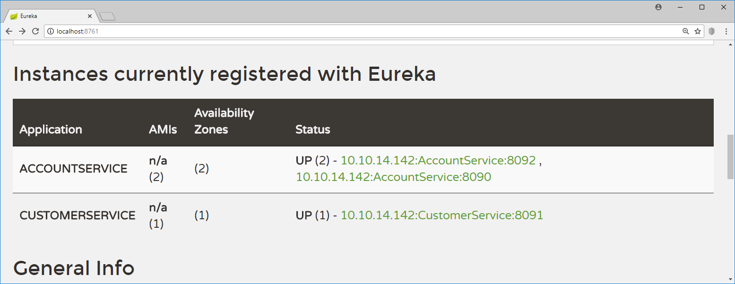
2 instances of AccountService
localhost:8090
localhost:8091
AccountService
CustomerService
AccountService
localhost:8092

Slide 24
Load balancer
localhost:8090
AccountService
Load balancer
Browser
CustomerService
localhost:8091
AccountService
query
Registry service
localhost:8092
Client side load balancing:
Cache the location of the services

Slide 25
CustomerService calls AccountService
@RestController
public class CustomerController {
@Autowired
AccountFeignClient accountClient;
@RequestMapping("/customer/{customerid}")
public Account getName(@PathVariable("customerid") String customerId) {
Account account = accountClient.getName(customerId);
return account;
}
@FeignClient("AccountService")
@RibbonClient(name="AccountService")
interface AccountFeignClient {
@RequestMapping("/account/{customerid}")
public Account getName(@PathVariable("customerid") String customerId);
}
}
Use Feign to call another service
Use Ribbon for load balancing

Slide 26
Load balancer
localhost:8090
AccountService
Load balancer
Browser
CustomerService
localhost:8091
AccountService
query
Registry service
localhost:8092
Refresh periodically
The load balancer will use Round Robin by default.
If you stop one instance of AccountService, automatically the other instance will be used.
If you start the second instance again, it will use Round Robin again.

